Slide 1

Evolutionary Game Theory in Growing Populations
C. BRUGUERA VICENTE

Slide 2
Index
Introduction
Background: Birth-death model & Prisoner’s dilemma game
Model modification
Result: Dynamics
Result: Competition between selection and growth
Conclusions

Slide 3


Introduction
Evolutionary game theory
Ecology
Species’ Traits/Strategies: A, B
Fraction of individuals with A: x
Dynamics: Replicator equation
Total size of population: N
Notes:
Classical ev. Game theory
their relative frequency

Slide 4
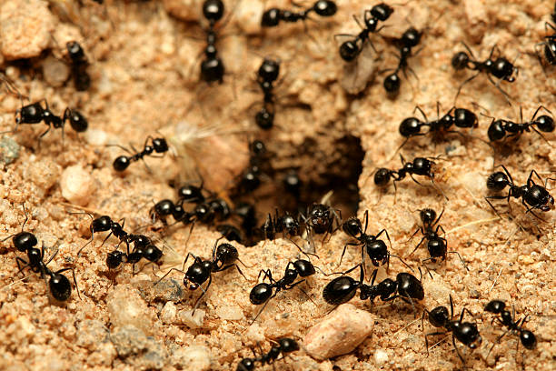
Introduction
Internal strategy and total population are not independent.
New ant colony:
Individuals that cooperate by foraging, defending the nest, or caring for larvae increase the growth rate and survival of the colony.

Slide 5


General model
Birth-death dynamics
Notes:
G/D: per capita birth/death rates of type S
Multiplying by Ns gives the total rate for the subpopulation of type S

Slide 6

General model
Deterministic limit
Notes:
The deterministic description is obtained by replacing the discrete birth and death events by their average effect per unit time. Since a birth event of type S changes NS by +1, while a death event changes it by −1, the average rate of change of NS is:

Slide 7

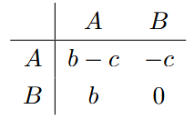
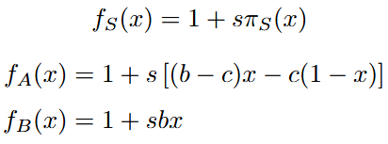
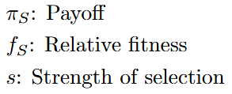

Prisoner’s dilemma game
Defectors have advantage
Notes:
payoff matrix: where the rows indicate the strategy of the individual and the columns the strategy of the individual they interact with.
s: Controls how fast internal composition changes
defectors always have a relative fitness advantage over cooperators

Slide 8
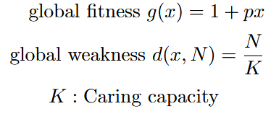
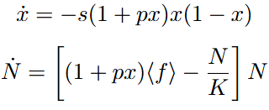

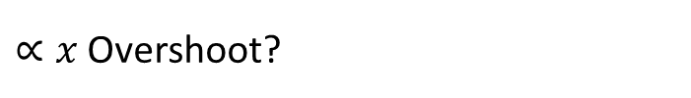
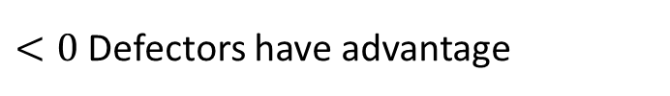
Model modification
Deterministic eq.
$<0$ Defectors have advantage
$∝x$ Overshoot?
Notes:
Although defectors have a relative fitness advantage, cooperators still affect the population at the global level. To include this effect, the global fitness is chosen linear with x.
K represents the carrying capacity associated with resource limitation.
A large value of x

Slide 9
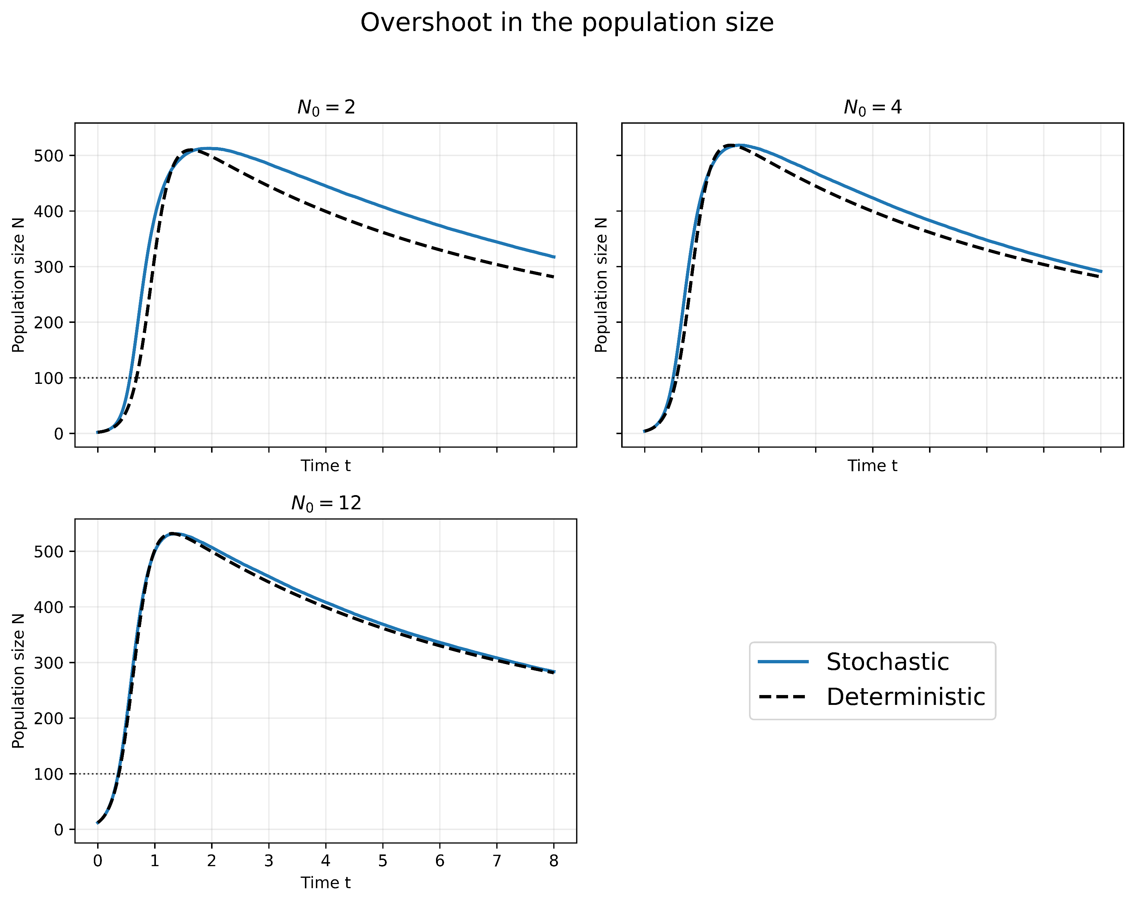
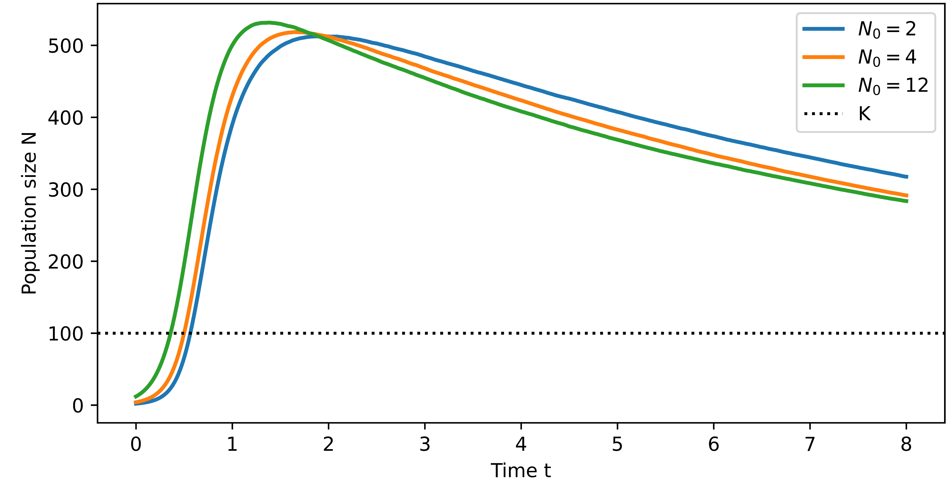

Average population dynamics
(Fig1) Overshoot in N: When the initial fraction of cooperators is large enough, the population first grows. Then, selection reduces it.
(Fig2) Smaller $N_{0}$ are the more affected.

Slide 10
Average population dynamics
Overshoot is captured both stochastically and deterministically, indicating that this effect mainly follows from the coupling between population growth and internal composition.

Slide 11
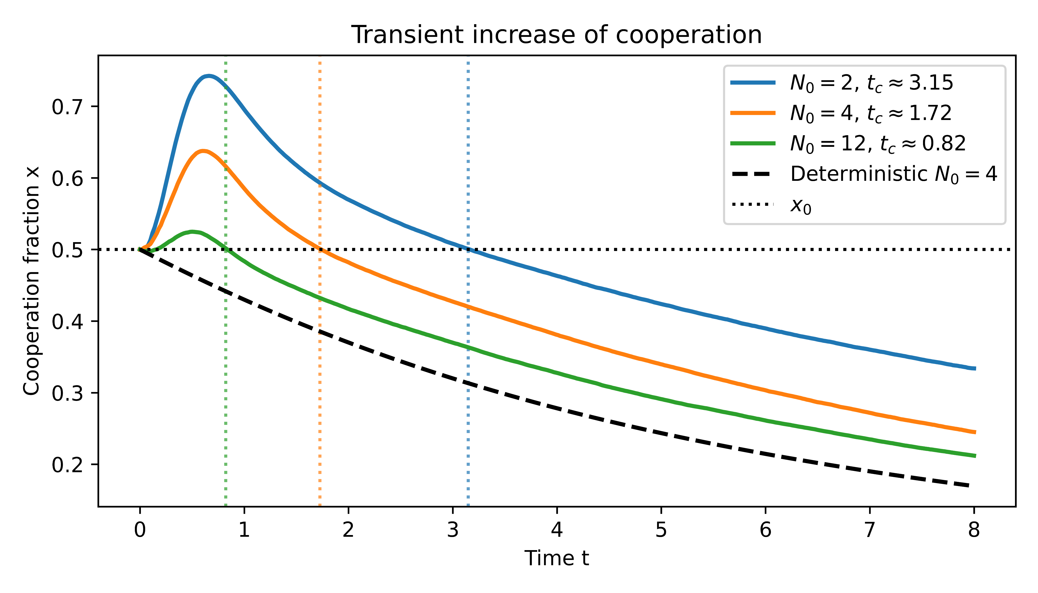


Average cooperator fraction dynamics
Deterministic trajectory
Decreases monotonically
Stochastic trajectory
Transient increase in $x$, especially for small $N_{0}$. Some realizations contain, by chance, a larger fraction of cooperators, and these populations grow faster because cooperation enhances global growth.
Cooperation time $t_{c}:x>x_{0}$

Slide 12
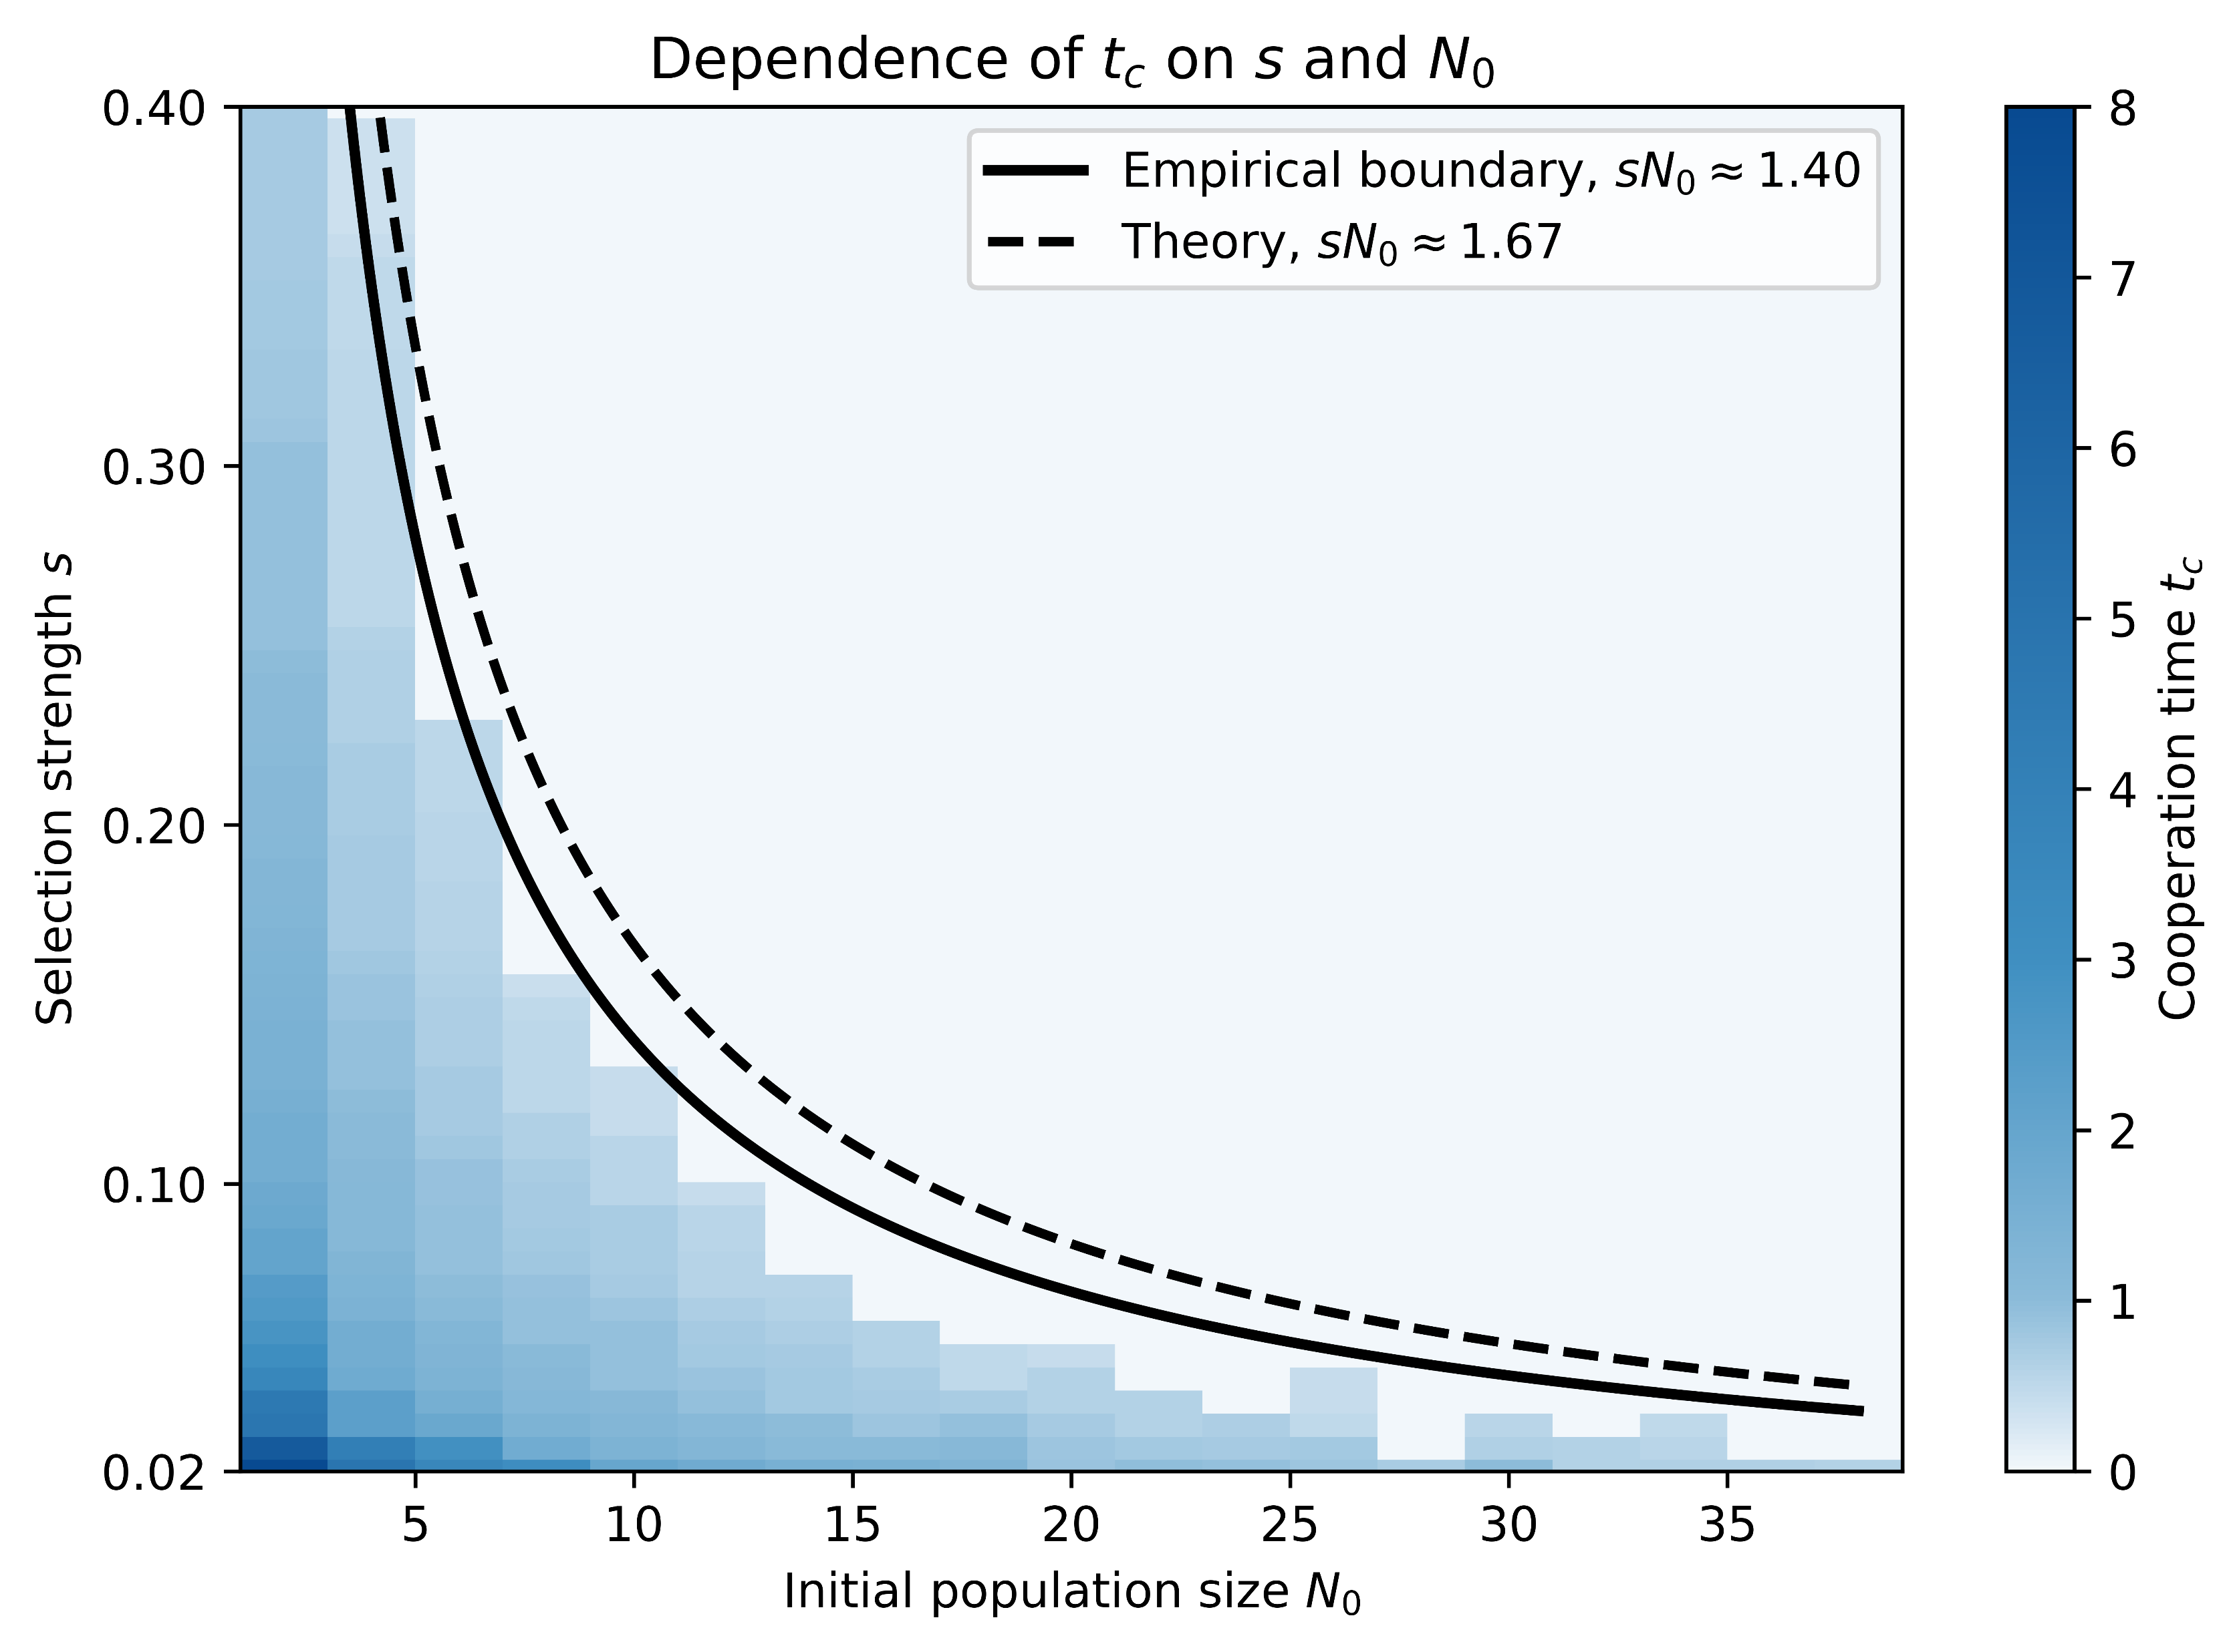



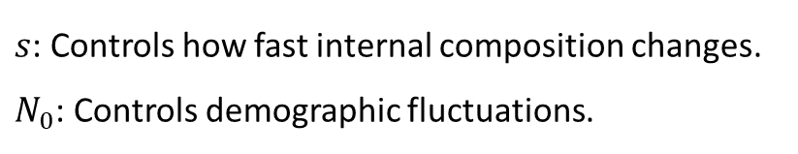
Competition between selection and growth
v
$s$: Controls how fast internal composition changes.
$N_{0}$: Controls demographic fluctuations.
$$t_{c}\left(s,N_{0}\right)$$
(Fig 4) $t_{c}$ vanishes as $s$ and $N_{0}$ increases.
Analytical boundary (Appendix)

Slide 13
Conclusions
Coupling evolutionary dynamics with population growth changes the behavior expected from the deterministic replicator equation:
Deterministic model: cooperators always decrease because defectors have a relative fitness advantage.
Stochastic model: small populations can display a transient increase in cooperation when selection is weak and the initial population small. This increase is not caused by selection favoring cooperators, but by the amplification of early demographic fluctuations during the growth phase.
Therefore, the population size cannot always be treated as a constant variable in evolutionary game theory.

Slide 14
Thanks! <3

